Slide 1

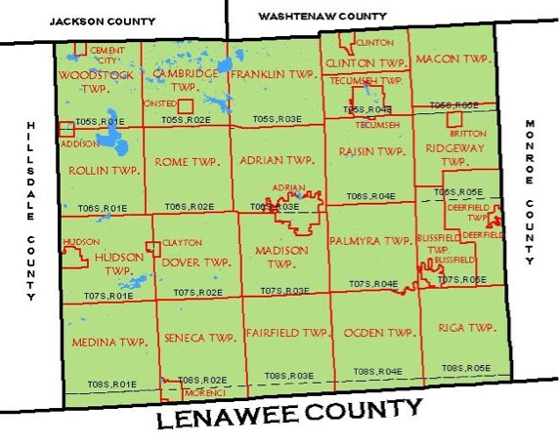
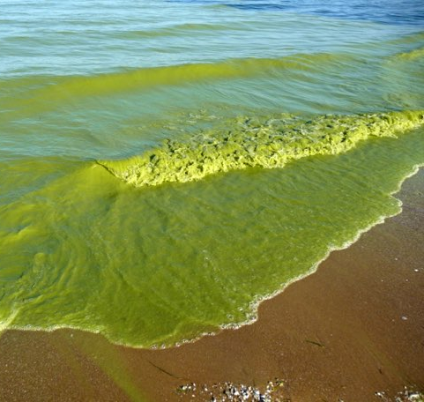
Lenawee County and Lake Erie
Photo by Tom Archer, September 2009
Notes:
All of Lenawee County drains in to Lake Erie. This equals 1/3 of the land in Michigan affecting the Lake. This means we have a huge affect on the quality of the water in Lake Erie. This also means we are the source of some of the pollution turning Lake Erie Green

Slide 2

Phosphorus
Dr. Phosphorus
Photo by Tom Archer, September 2009
Notes:
This pollutant is called Phosphorus, Phosphorus is like Doctor Jekyll and Mr. Hyde. Mr. Phosphorus is a hero when he helps plants grow and makes our bones strong. But release him into our waterways and he quickly morphs into Dr. Phosphorus, an evil polluter that poisons our rivers and turns our lakes green.

Slide 3

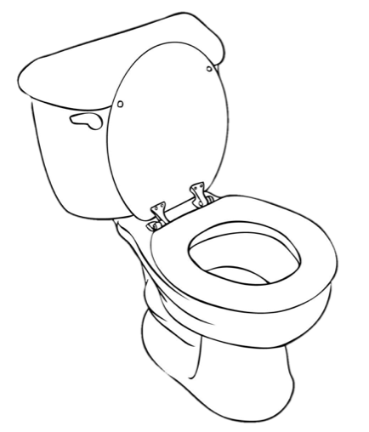

Two Sources
Notes:
Mr. Phosphorus is found in the sewage that comes from our toilets and attached to the soil in Crops field. In Lenawee county our Phosphorus located in both sewage and crops field. Seventy percent of the square miles are utilized by agricultural, and we have 10 cities and villages in the county.

Slide 4
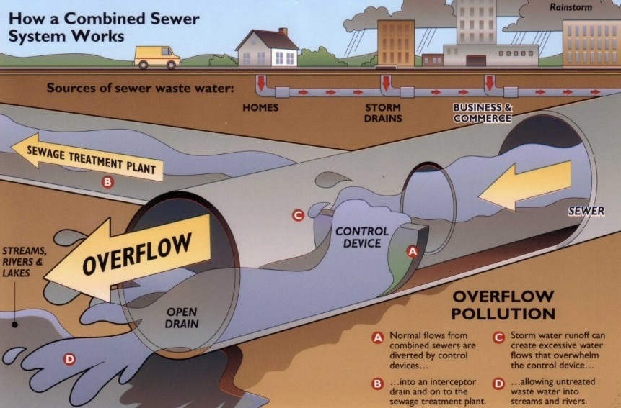





Cities
Notes:
When Mr. Phosphorus is in the city he normal travels from homes, storm drains and business straight to the water treatment plant where he can be concentrated an used to fertilize plants and help them grow. Let watch Mr. Phosphorus stroll along the cities sewage pipes to the sewage treatment plant.

Slide 5
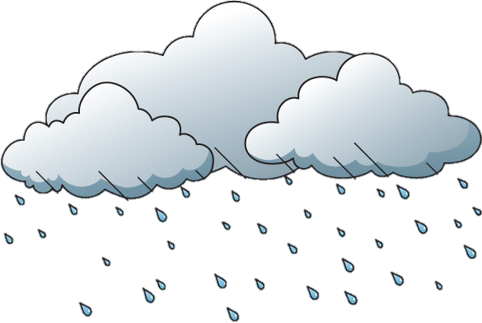

Cities
Notes:
That all changes when storms blow in and Mr. Phosphorus turns into Dr. Phosphorus. Dr. Phosphorus overwhelms the sewage system and makes his way from the houses, storm drains and business straight into the River Raisin. Let watch Dr. Phosphorus roar through the pipes.

Slide 6




Farming
Hi, I am Sammy Soil
Notes:
Mr. Phosphorus also like to be in the county. While in the country he spends most of his time with Sammy Soil. They are so close you might even say they are chemically attached at the hip. They spend most of their time together helping plants grow and make food. However….

Slide 7


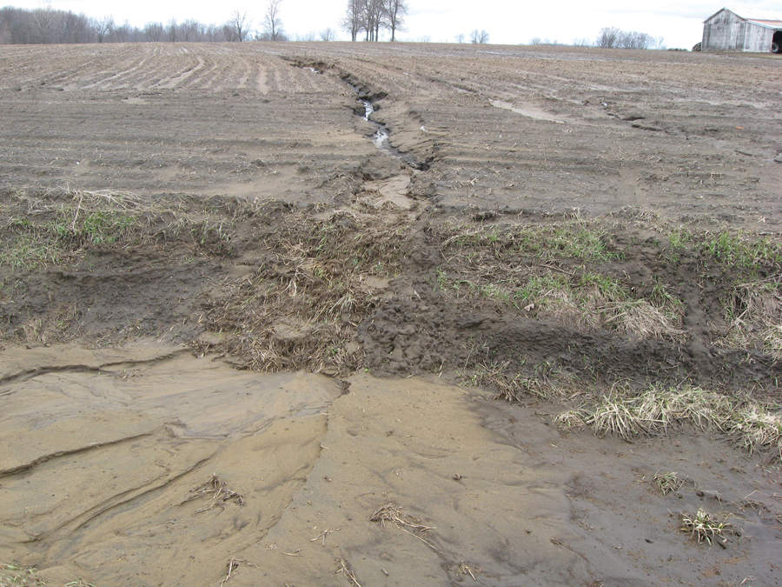

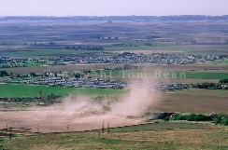
Types of Erosion on Farms
Water
Wind
Notes:
…a storm blows in and turns Mr. Phosphorus into Dr. Phosphorus. Dr. Phosphorus convinces Sammy to leave the crop field into way. 1. The travel though gully that rips across the farm field an into the ditch. 2. Ride the wind until they land on the lake.

Slide 8

Problems from Erosion
Poor Soil Quality
Notes:
Dr. Phosphorus’ shenanigans cause big problems. Plants struggle to grow in the fields because Sammy and Mr. Phosphorus are no longer in the field help feeding the plants.

Slide 9
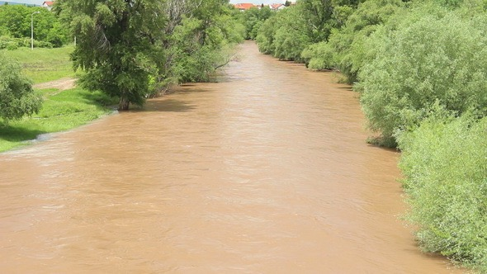

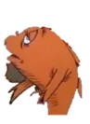

Muddy Rivers
(turbidity)
Notes:
Sammy turns the river muddy, this is called Turbidity. Turbidity cause fish to struggle to find food and have a hard time finding a home.

Slide 10
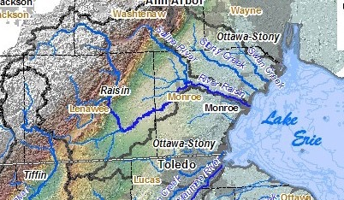
Rivers Deliver Phosphorus to the Lake
Notes:
Once Dr. Phosphorus makes his way to the river. For Tecumseh Dr. Phosphorus enters The River Raisin. Lets watch and see where they end up.

Slide 11
Rivers Deliver Phosphorus to the Lake
Notes:
As you can see Sammy and Dr. Phosphorus end of and Lake Erie. Did anyone notice what happened at the lake when he arrived there?

Slide 12
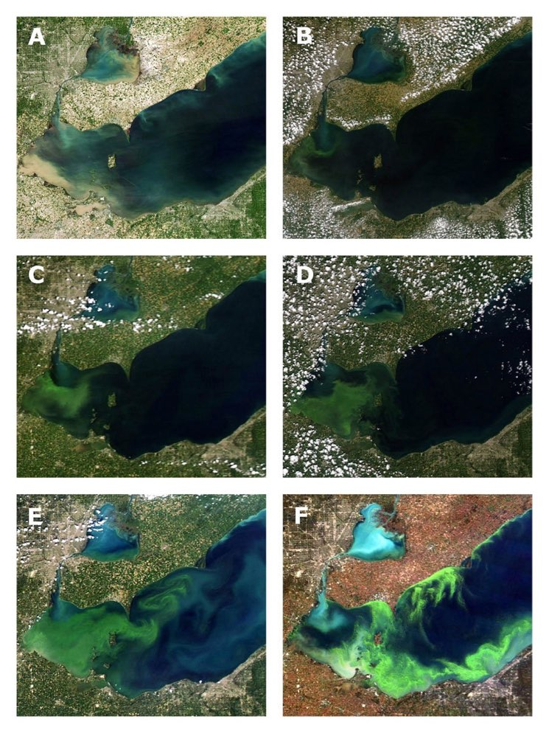
Algae Bloom
Notes:
The green coloration in Lake Erie is not Phosphorus it is large areas of Algae. While the algae is always present in the Lake it only grows into large blooms when there is the presence of high levels of Phosphorus. Just like in the crop fields and our bodies Phosphorus is used by the algae to grow. The more Phosphorus the more algae. The results of these blooms are very damaging to recreation, wildlife and drinking water for many cities bordering the lake.

Slide 13
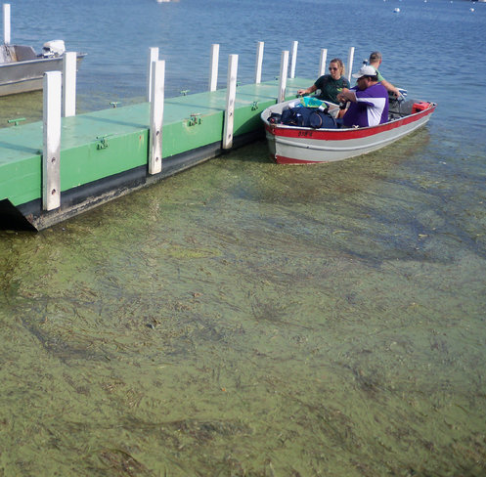
Boating anyone?
Photo by Brenda Culler/ODNR Coastal Management

Slide 14
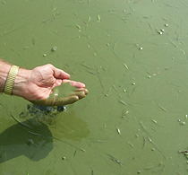
Would you want to swim in this water?
Photo by Dr. J.M. Reutter, Ohio

Slide 15
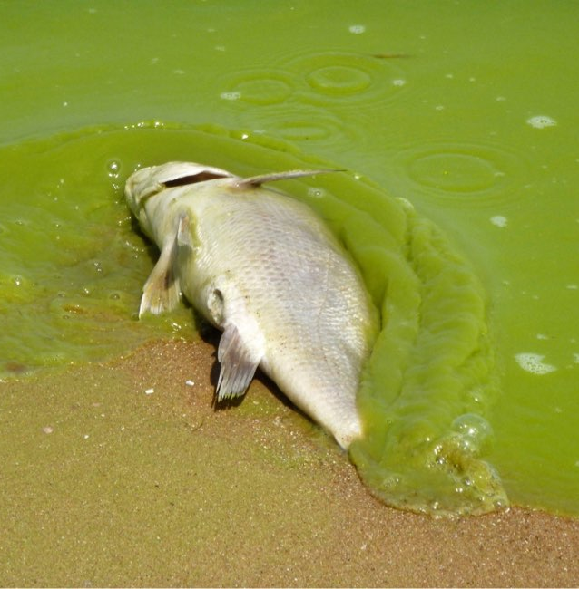
A fishing trip?
Photo taken by Tom Archer August, 2011.

Slide 16
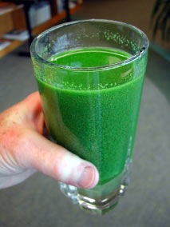
A Nice Drink of Water?
Photo by Dr. Tom Bridgeman,
University of Toledo

Slide 17
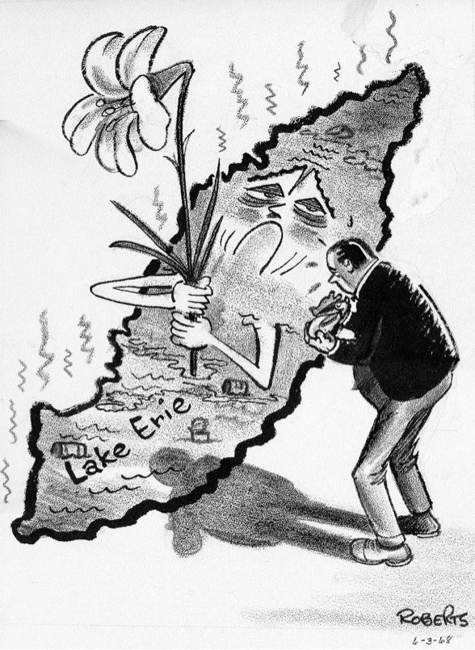
This is has happened in the past.
The lake itself nearly died once before. In 1969, Time magazine practically wrote its obituary,
Notes:
For many of us this is the first time we have heard about the such serious problems in the Lake, however, this is not the fist time it has happened. In the 1960’s the lake struggled with the same issue. In 1969 the lake became so bad Time Magazine wrote a satire piece declaring the Lake dead.

Slide 18



Dr. Seuss’ The Lorax, 1971
“You’re glumping the pond where the humming fish hummed. No more can the hum for their gills are all gummed. So I’m sending them off. Oh , their future is dreary. They’ll walk on their fins and get woefully weary, in search of some water that isn’t so smeary. I hear things are just as bad up in Lake Erie.”
Notes:
Time magazine wasn’t the only one concerned about the Lake in 1971 Dr. Seuss used Lake Erie as one of his inspirations for writing The Lorax and included a line about Lake Erie in the book. (play sound) As you can hear this line made it into the original Lorax movie. In the mid 1980’s Dr. Seuss removed the line, after the Lake cleared up. Since the lake has been fixed before that means we can fix it again.

Slide 19

What can you do?
Image: The Lorax (2012), Universal Studios
Notes:
In the words of the Lorax What can you do?

Slide 20

Farmers can Stop Soil Erosion
Notes:
If you are a farmer you can keep Sammy and Mr. Phosphors on your farm fields. There are lots of way to keep Mr. Phosphorus from turning into Dr. Phosphorus.

Slide 21
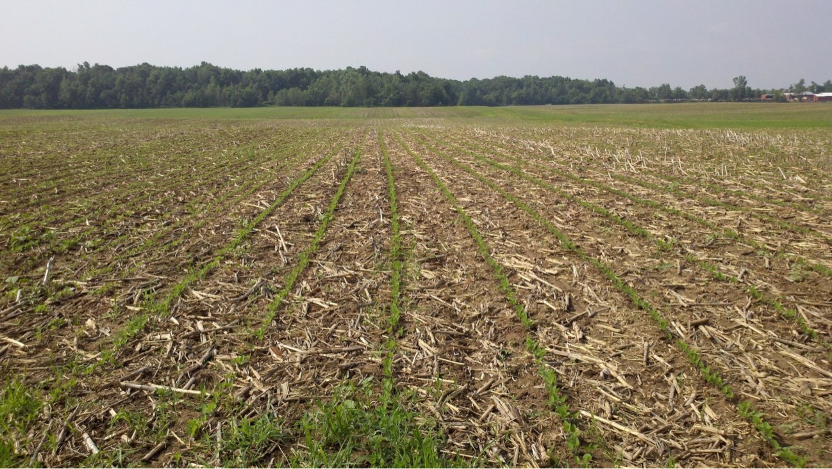
Crop
Residue
Notes:
Crop Residue is a the practice of leaving the dead plants on the surface of the ground. This provides protection from the wind and water, and prevents soil and Phosphorus from leaving the farm field.

Slide 22
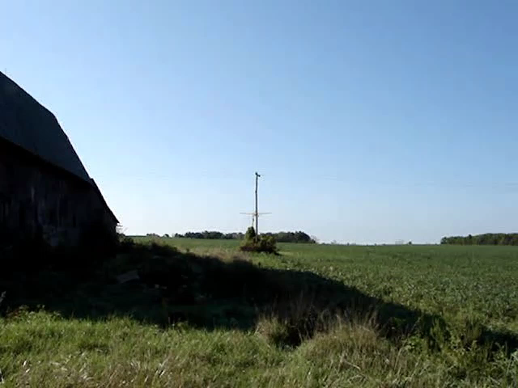
Cover Crops
Notes:
Cover Crops are plants that are grown from the time the crop (corn, soybean and wheat) is harvest until the next crop is planted. This helps in two ways, cover crops shelter Sammy and Mr. Phosphorus from the wind and rain, as well as, provide roots for Sammy to hold onto. (click to play video)

Slide 23
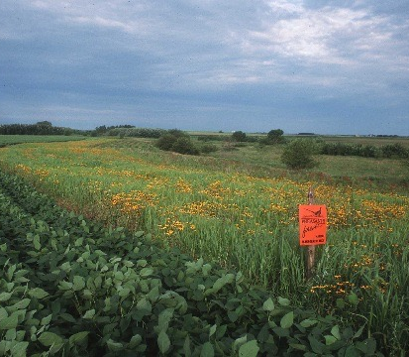
Filter Strips
Notes:
Filter strips are that last defense when it comes to keeping Sammy and Mr. Phosphorus from getting into trouble. The tall grasses and plants catch soil and phosphorus before it enter into the rivers and diches.

Slide 24



Homeowners
Stop using Phosphorus Fertilizers on their lawn
Notes:
You don’t have to be a farmer to help keep Dr. Phosphorus from causing havoc in Lake Erie. Anyone with a lawn can help by not using Phosphorus fertilizers on their lawn. The majority of lawns are not lacking in phosphorus. This is because grass is never removed from the lawn, the Phosphorus is released from the grass when it is mowed and used by the plants again.

Slide 25
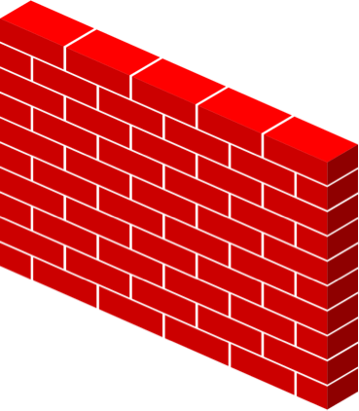
Cities
Stop sewage from entering streams
Notes:
Cities can do their parts by updating their sewer systems to stop Dr. Phosphorus from escaping and reeking havoc on Lake Erie.

Slide 26


Everyone
Support Local Conservation Farms and Conservation Districts
Notes:
Everyone can buy local from farms that implement practices to keep Mr. Phosphorus from turning into Dr. Phosphorus. Also, supporting the Conservation District allows us to provide education to more people and stop Dr. Phosphorus is his tracks. Does any one have any questions?

