Slide 1

by Robert “Skip” Richter
County Extension Director - Travis County Texas AgriLife Extension Service.

Slide 2
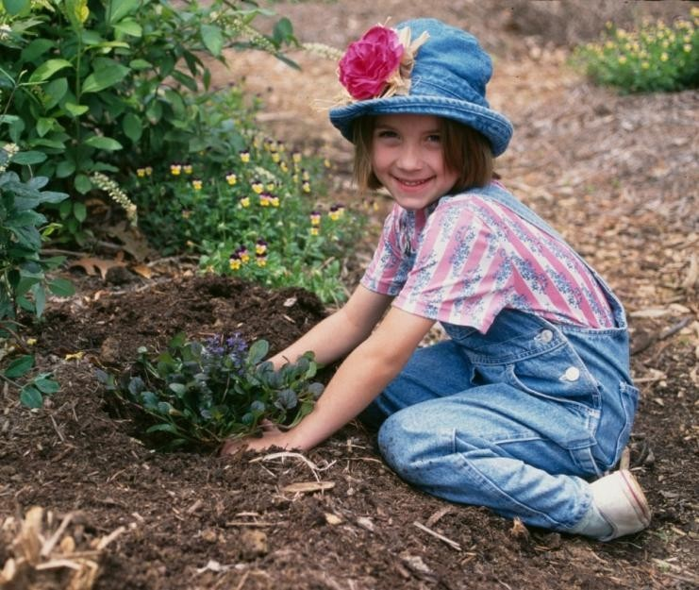
Composting is fun!
It's also easy.
Let's learn about how we make compost and how we use it to grow beautiful gardens.

Slide 3
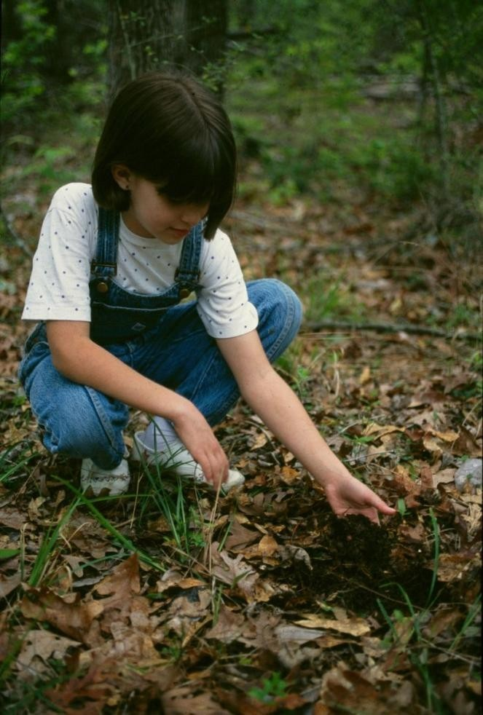
The Forest Floor
Nature recycles leaves and plants.
In a forest, leaves fall forming mulch that protects the soil.
Over time they decompose into nutrients that feed forest plants.

Slide 4
Making Compost in a Bin
You can recycle leaves and other plant materials at home by setting up a compost bin.

Slide 5
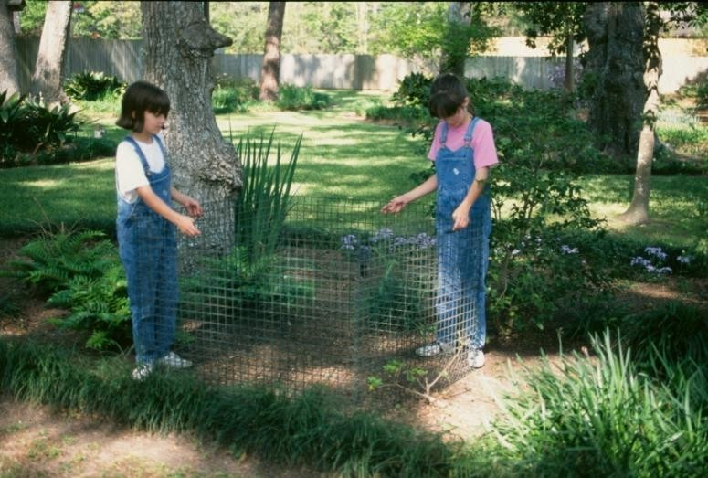
Set Up the Bin
First select a spot to set up your bin. It should be out of the way but convenient to reach with plenty of room to work around. Some good places would be near your garden or in a back corner of the yard. It is also a good idea to choose a location close to a source of water.

Slide 6
Compost Recipe
Now for the recipe for compost. The micro- organisms that recycle leaves and other plant parts need an even mix of brown stuff and green stuff to munch on. They also need air and water to live and work. Put all this together and in time you will have compost!

Slide 7
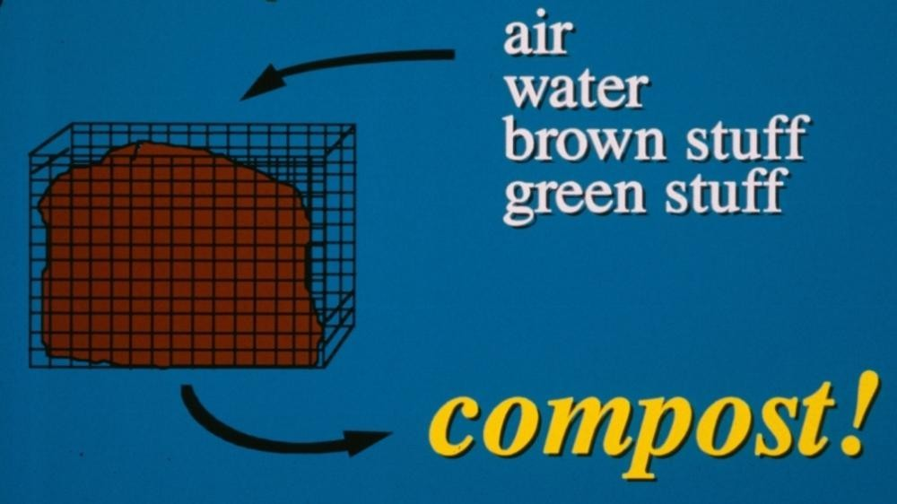
Recipe Ingredients

Slide 8
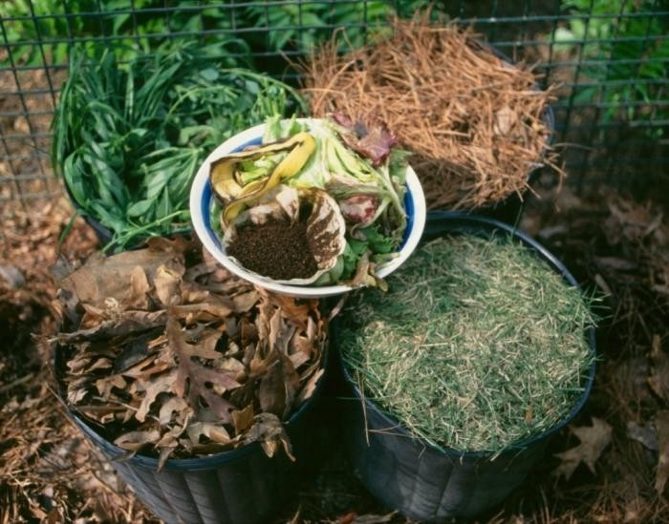
Five Containers of Ingredients
Brown stuff is dead, dried plant parts like leaves and pine needles. Brown stuff is high in the element carbon. Green stuff is fresh, living parts like grass clippings, kitchen vegetable scraps, weeds and other plants. Green stuff is high in the element nitrogen.

Slide 9
Don't Use
Meat | Bones | Cheese
Fat | Milk | Oils
Pet droppings | Diseased plants
Don't use meat, milk products because pets and other animals may try to dig them up out of your compost bin. Also don't use diseased garden plants. They can spread disease back into the garden later when you use the compost.

Slide 10
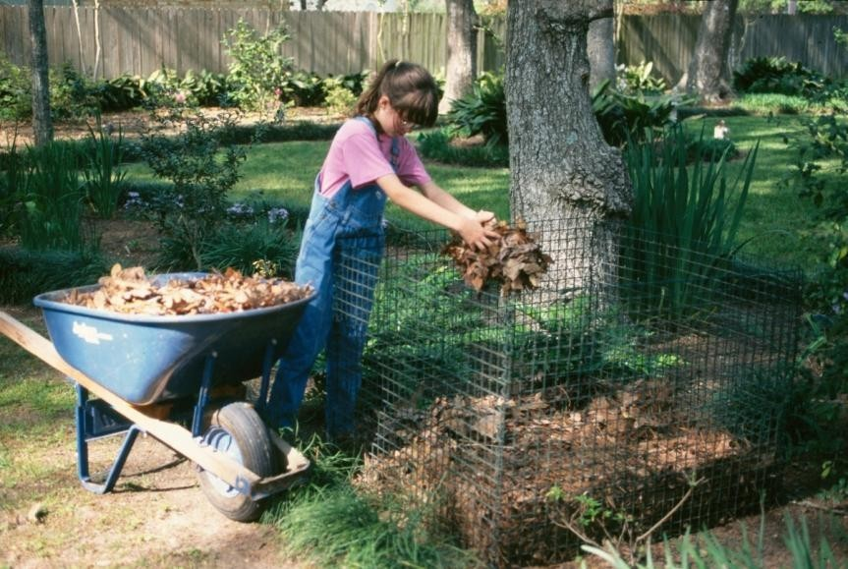
Add Leaves
It is easiest to build our compost bin in layers of ingredients. Start with the brown stuff by spreading a layer of leaves or pine needles about 6 inches thick.

Slide 11
Carbon Sources
Here are some sources of carbon along with their carbon-nitrogen ratio. You can use these numbers to better determine how much brown and green stuff you should use to make the best mix for composting. Some things, such as sawdust, are very high in carbon compared to their nitrogen content, while others, such as leaves, are not so high.

Slide 12
Carbon Sources
Dried leaves
Pine needles
Newspaper
  Sawdust
60:1
90:1
125:1
625:1

Slide 13
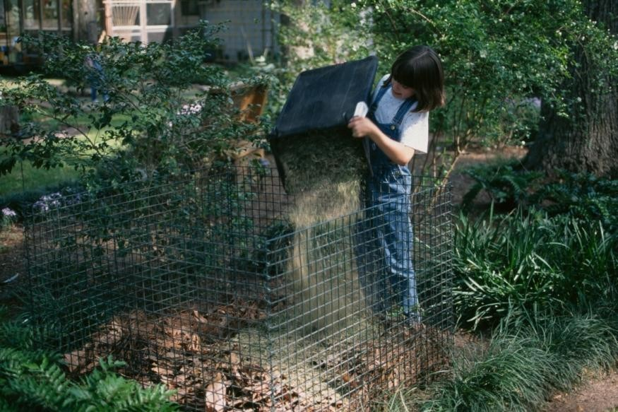
Add Grass Clippings
Next, for the green stuff, add a layer of grass clippings a few inches thick. It is helpful to mix the layers up a little as you make them.

Slide 14
Nitrogen Sources
Here are some sources of nitrogen along with their carbon-nitrogen ratio. Once again, you can see that the ratio varies a lot between the different ingredients.

Slide 15
Nitrogen Sources
Food Scraps
Grass clippings18:1
Coffee grounds20:1
Horse manure 25:1
15:1

Slide 16
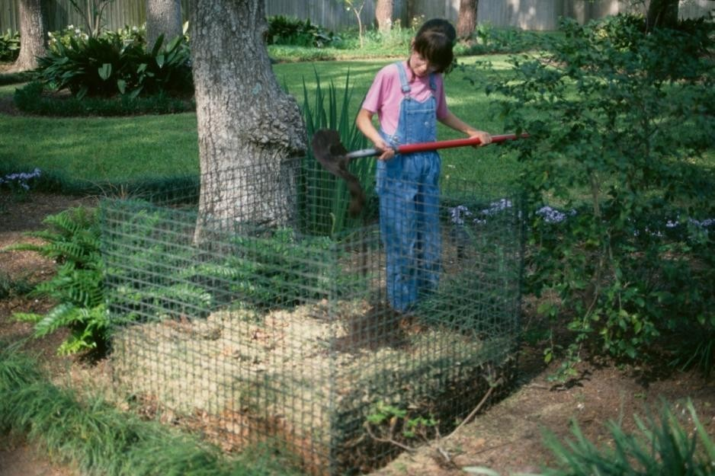
Shovel the Soil
Then sprinkle a shovelful of soil or compost to add microorganisms to the bin.

Slide 17
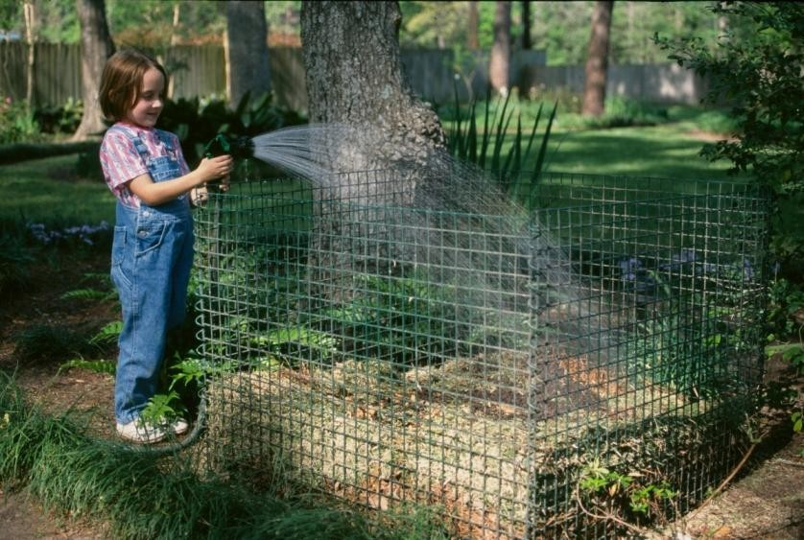
Watering
Each layer gets a good sprinkling of water to wet the ingredients. It is important to wet each layer as you build it. Repeat each of the layers until the bin is full and then.....

Slide 18
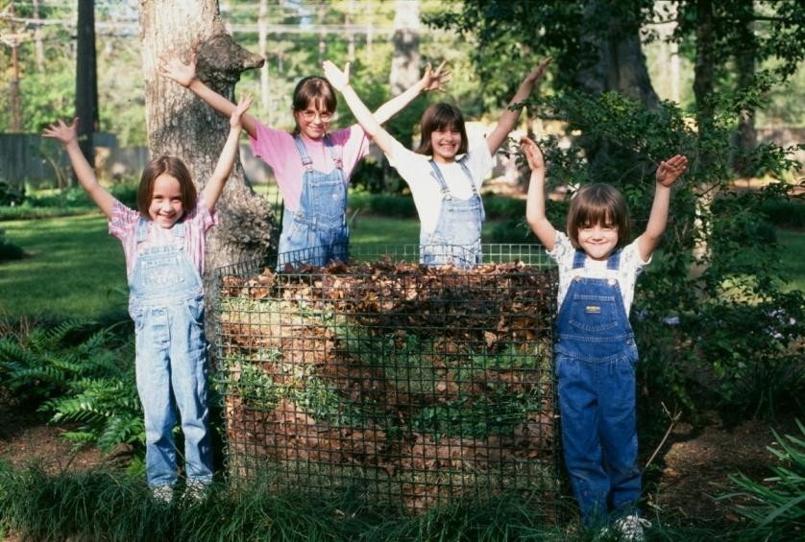
Finished Bin!
...TAH DAHHHHH! the microorganisms will go to work breaking down the ingredients into humus. If you want faster compost, you can mix the ingredients every few weeks but this isn't necessary.

Slide 19
Compost “Critters”
Now tiny microorganisms (that you cannot see without a microscope) go to work breaking down the organic matter into compost. Later, as the compost cools down, you may see larger organisms such as millipedes, sowbugs, earthworms and others. Compost is teeming with living things!

Slide 20
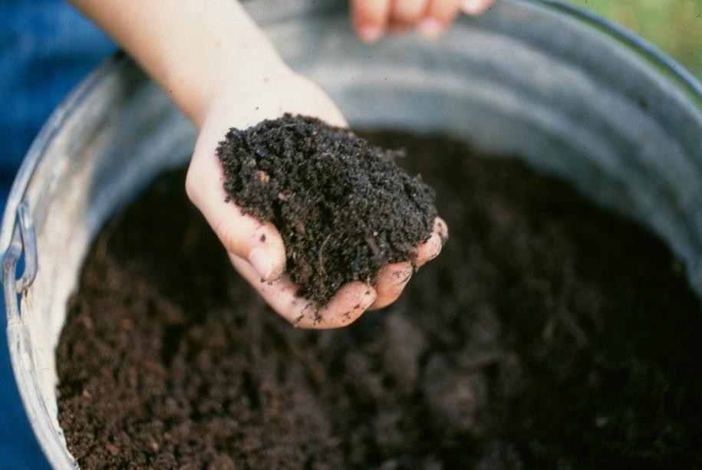
Handful of Compost
This is compost, the dark, earthy-smelling stuff is rich in nutrients. Plants love it! Let's talk about how to use compost to help plants grow.

Slide 21
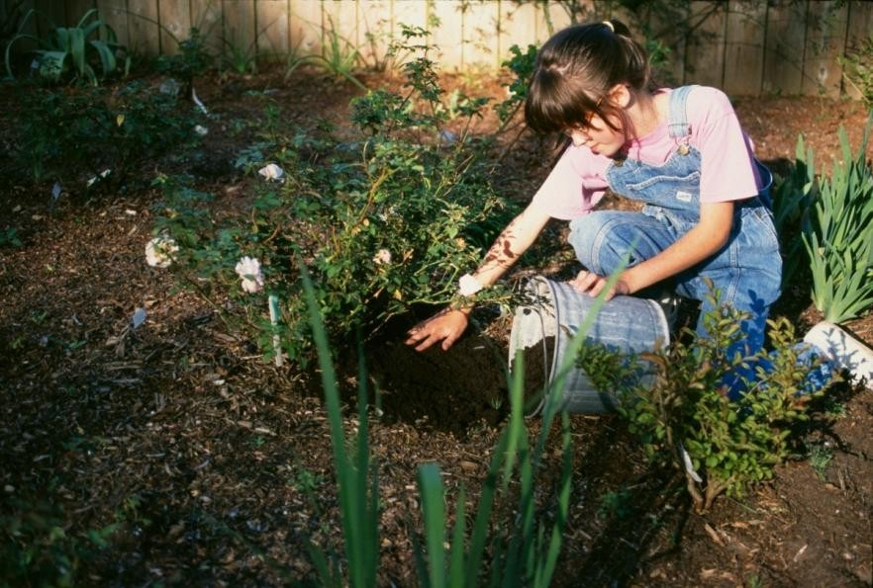
Use Compost
as Mulch
You can use compost as a mulch around garden plants, like this rose bush. Mulch protects the soil and shades out weed seeds. Nutrients are washed out into the soil with each rain to feed the roots of plants.

Slide 22
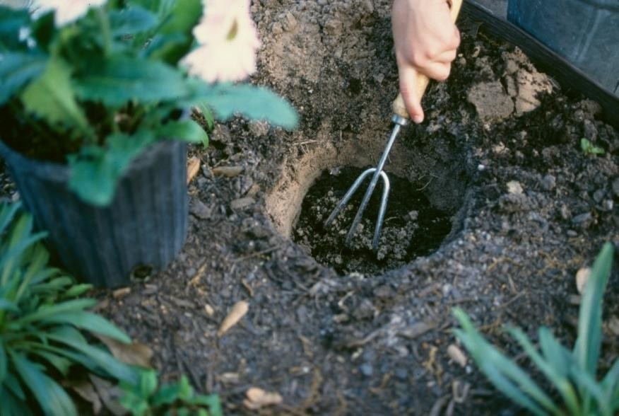
Mix Into Planting Hole
Compost is great for mixing into the soil when you are planting a new plant like this flower! It helps a sandy soil hold moisture and nutrients better and improves clay soils too.

Slide 23
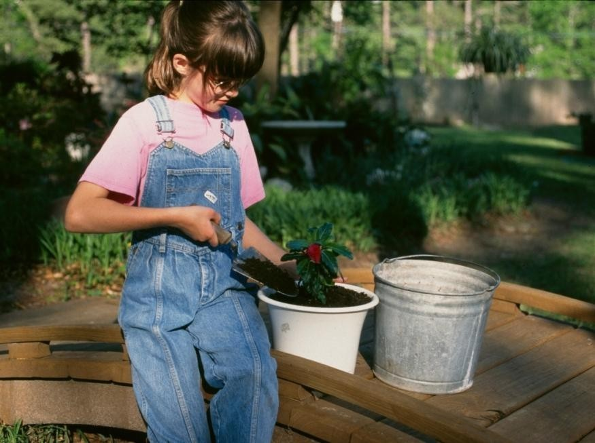
Use Compost in Potting
Soil
Compost mixed with some sand makes a super potting soil for growing plants in containers.

Slide 24
Trench Composting
Another way to compost in the garden is by trench composting.

Slide 25
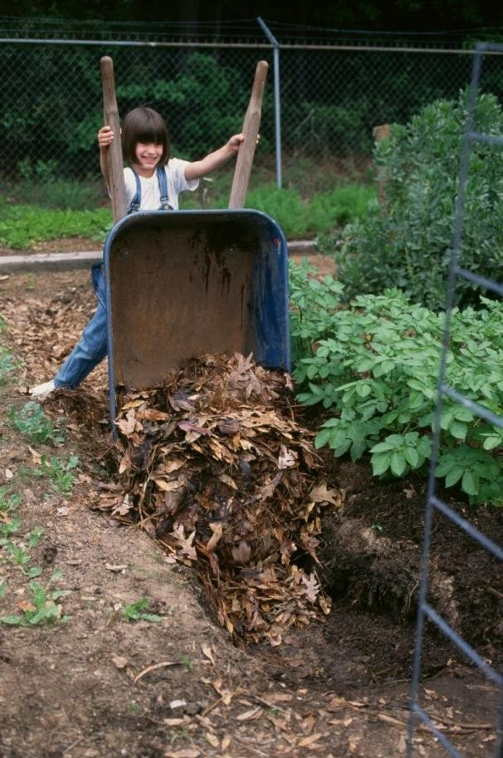
Dumping Leaves In Trench
Start by placing leaves in the trenches between raised beds, or in the pathways through your garden.

Slide 26
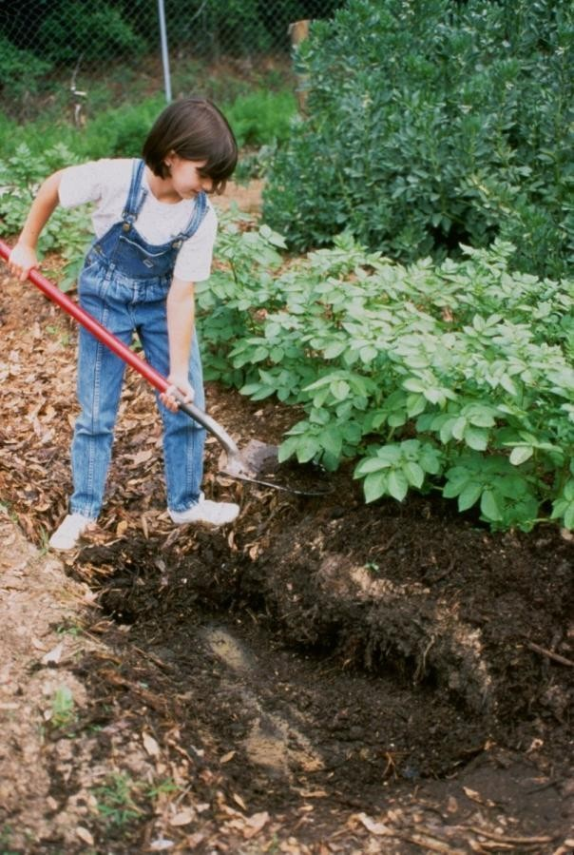
Shoveling Compost from Trench
By the end of the gardening season these leaves will be mostly decomposed and can be scooped up and placed around garden plants as an excellent mulch. Or, you can mix them into the planting beds to improve the soil.

Slide 27
Compost “Pockets”
Another way to compost in the garden is by making compost pockets. They are easy and fun.

Slide 28
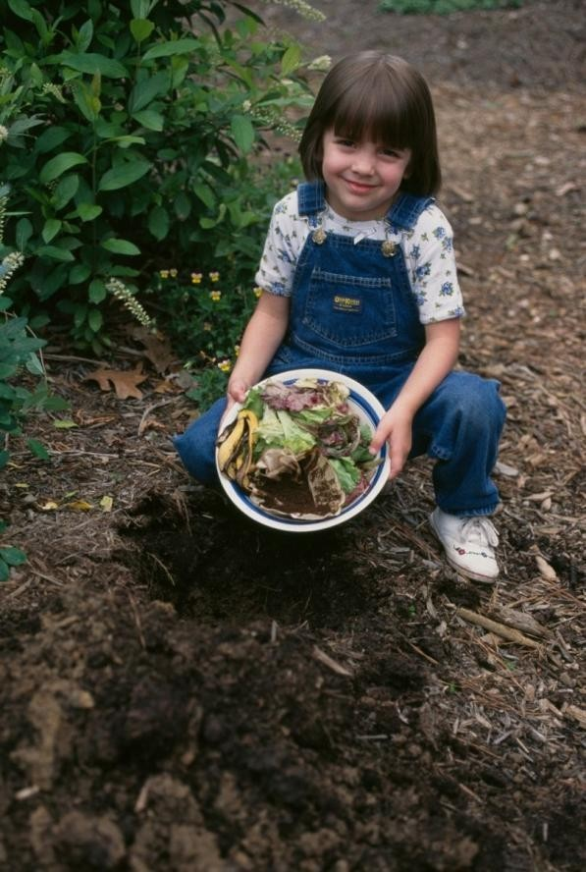
Start by digging a hole about 18" deep. Place fruit, vegetable scraps and coffee grounds from the kitchen in the hole.
Don't use meat, fat, milk or eggs because pets or
wild critters will try to dig them up for lunch!

Slide 29
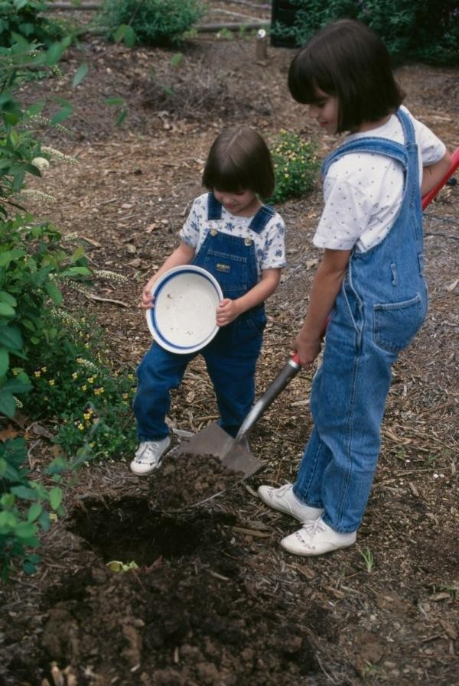
Covering With Soil
Next, cover the scraps with soil to bury them and fill the hole. Now you can make more compost pockets in other locations!

Slide 30
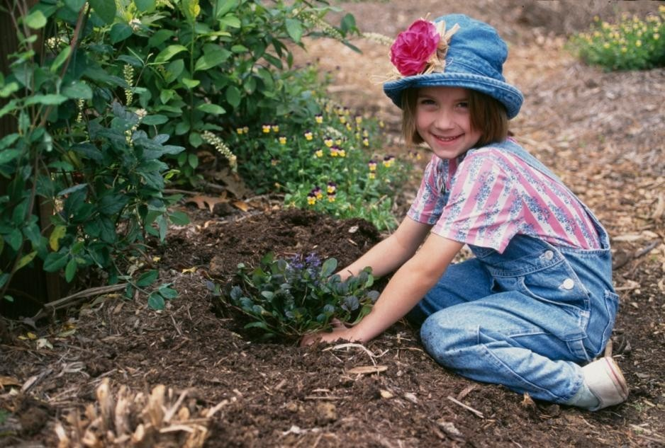
After about a month or two you can plant a flower or maybe a tomato plant on the spot where you make the compost pocket. Then stand back and watch it grow!

Slide 31
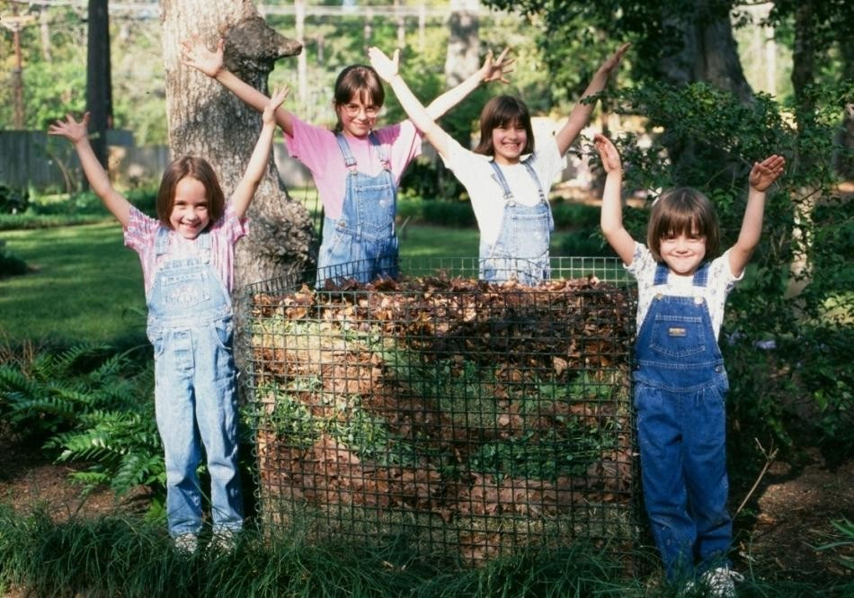
The End
by Robert “Skip” Richter
County Extension Director - Travis County Texas AgriLife Extension Service.

